Slide 1
Competitive Events CRASH COURSE
Montana FCCLA
2020-2021

Slide 2
Goals for Today
Explore competitive STAR events
Understand current resources to aid in choosing events
Collective thoughts/ questions/ comments

Slide 3
Baking and Pastry
Career Investigation
Chapter in Review Display/Portfolio
Chapter Service Project Display/ Portfolio
Culinary Arts
Culinary Math Management
Digital Stories for Change
Early Childhood Education
Entrepreneurship
Event Management
Fashion Construction
Fashion Design
FCCLA Chapter Website
Focus on Children
Food Innovations
Hospitality, Tourism, and Recreation
Instructional Video Design
Interior Design
Interpersonal Communication
Job Interview
Leadership
National Programs in Action
Nutrition and Wellness
Parliamentary Procedure
Professional Presentation
Promote and Publicize FCCLA!
Public Policy Advocate
Repurpose and Redesign
Say Yes and FCS Education
Sports Nutrition
Sustainability Challenge
Teach and Train
Notes:
To Begin

Slide 4
Quick Term Guide
“Levels” –
1: Students in grades 7-8;
2: Students in grades 9-10;
3: Students in grades 11-12
“Individual vs. Team” – Students must complete the event on their own vs. with up to 2 other student members
“Portfolio vs. Display vs. File Folder ” – Project will be presented using an official FCCLA binder vs. presented using a single or double ‘science fair’ board, or similar vs. submitting required documents to judges for review, in addition to oral presentation

Slide 5
Baking & Pastry
Recognizes participants enrolled in a Family and Consumer Sciences culinary arts industry training program for their ability to demonstrate their baking and pastry skills through the preparation of a quick bread, choux pastry, cookie, and shaped yeast bread. Participants must develop a plan for the time allotted, prepare menu items given to them at the time of the event, and present prepared items to evaluators.
Level 3
Individual
Notes:
Now is an individual event and includes and ACF test
Active event with product – no portfolio or display
Must be recognized as an industry training program – paperwork can be filed with Megan

Slide 6
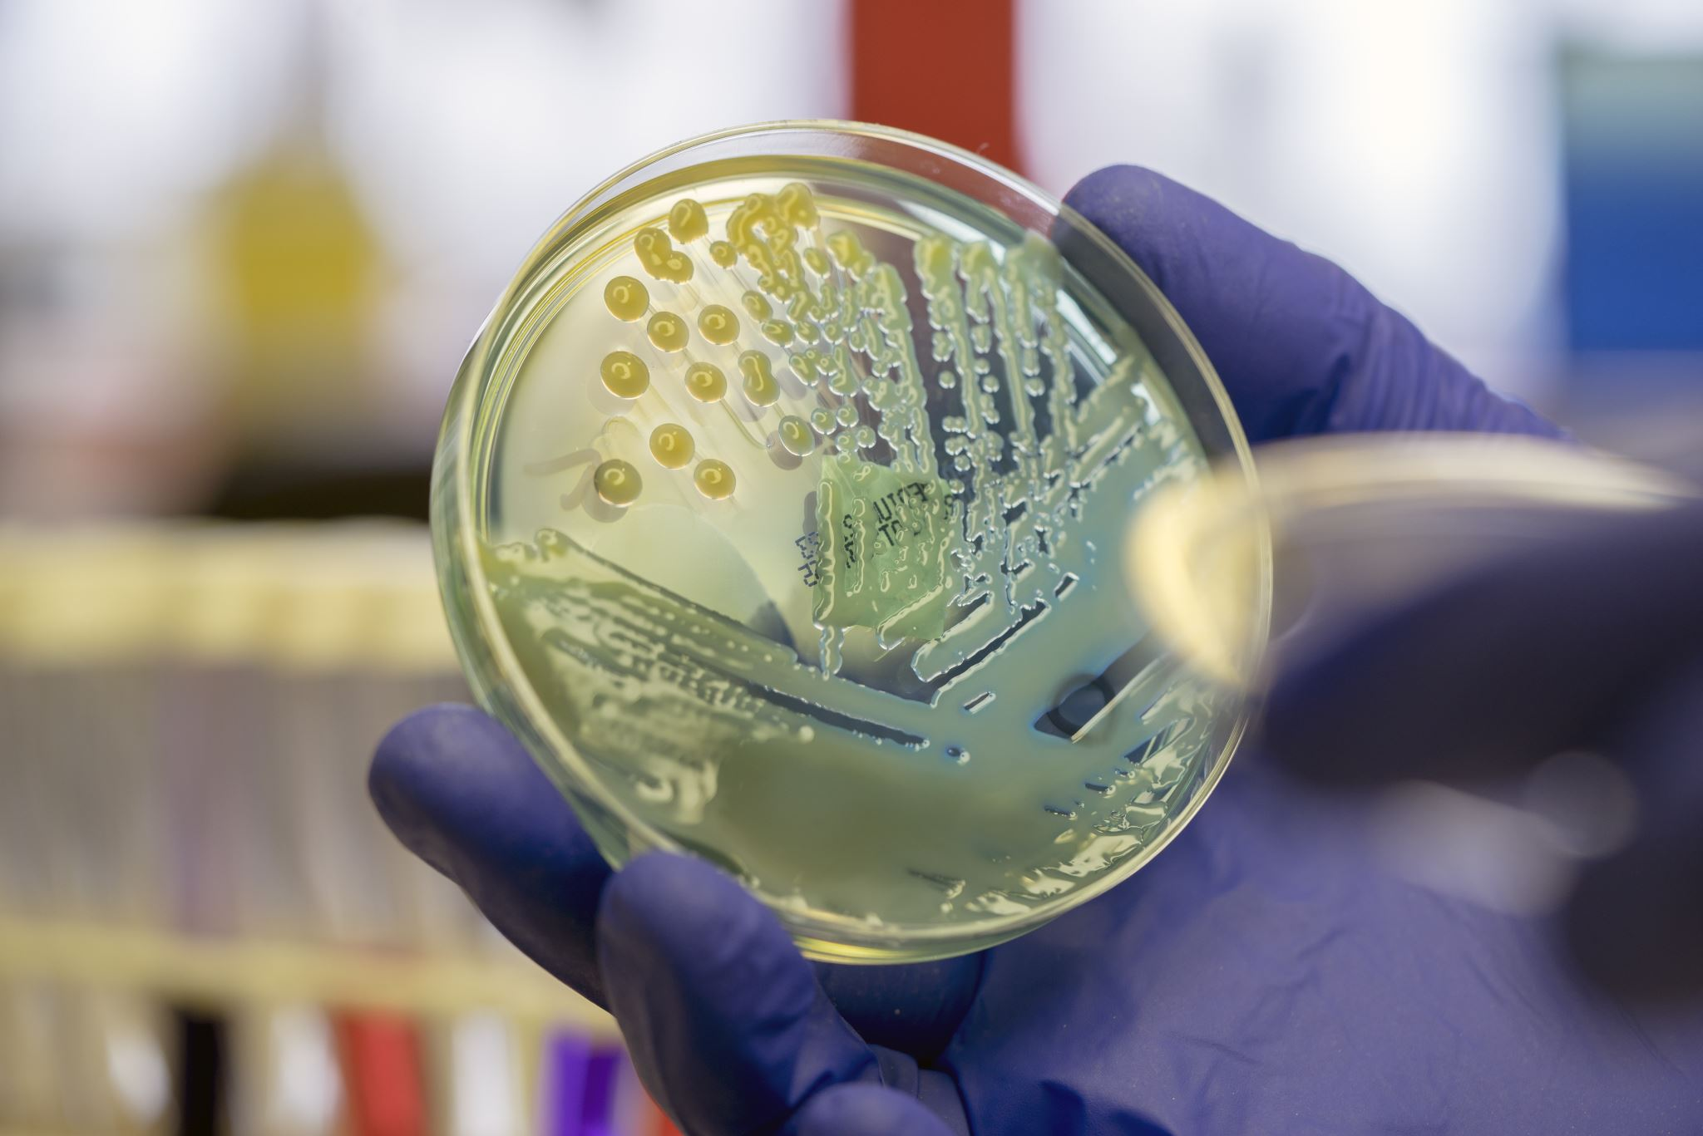
Career Investigation
Recognizes participants for their ability to perform self-assessments, research and explore a career, set career goals, create a plan for achieving goals, and describe the relationship of Family and Consumer Sciences coursework to the selected career.
Levels 1, 2, 3
Individual
Portfolio
Examples: Biochemistry, Police Officer
Notes:
Examples: Police Officer; BioChemistry Professor

Slide 7
Chapter in Review Display AND Portfolio
Recognizes chapters that develop and implement a well-balanced program of work and promote FCCLA and Family and Consumer Sciences and/or related occupations and skills to the community.
Levels 1, 2, 3
Team
Display or Portfolio – Separate Events
Notes:
Only ONE per chapter

Slide 8
Chapter Service Project Display AND Portfolio
Recognizes chapters that develop and implement an in-depth service project that makes a worthwhile contribution to families, schools, and communities. Students must use Family and Consumer Sciences content and skills to address and take action on a community need.
Levels 1, 2, 3
Team
Display or Portfolio – Separate Events
Examples: Biochemistry, Police Officer
Notes:
Examples: Police Officer; BioChemistry Professor

Slide 9
Culinary Arts
Recognizes participants enrolled in a Family and Consumer Sciences culinary arts industry training program for their ability to produce a quality meal using industrial culinary arts/food service techniques and equipment. Participants must develop a plan for the time allotted, prepare menu items given to them at the time of the event, and present prepared items to evaluators.
Level 3
Individual
Notes:
Now is an individual event and includes and ACF test
Active event with product – no portfolio or display
Must be recognized as an industry training program – paperwork can be filed with Megan

Slide 10
Industry Training Program
“Levels” –

Slide 11
Culinary Math Management
Recognizes participants who use Family and Consumer Sciences skills to demonstrate the application of mathematical concepts in the culinary arts industry.
Levels 3
Individual
File Folder
Examples: Biochemistry, Police Officer

Slide 12
Digital Stories for Change
Recognizes participants who demonstrate their knowledge, skills, and abilities to actively identify an issue concerning families, careers, or communities; research the topic; and develop a digital story to advocate for positive change.
The topic for 2020-2021 is “Human Trafficking.” Participants may choose to focus on education, prevention, advocacy or other activities to influence change.
Level 1, 2, 3
Individual or Team
ONLINE
Notes:
Now is an individual event and includes and ACF test

Slide 13
Early Childhood Education
Recognizes participants who demonstrate their ability to use knowledge and skills gained from their enrollment in an occupational early childhood program. On site, participants must plan and present to evaluators an activity related to the theme in response to a case study provided during the event and an oral presentation describing the activity.
2020–2021 Theme: “Community Helpers”
Level 3
Individual
Portfolio
Notes:
Examples: Police Officer; BioChemistry Professor

Slide 14
Entrepreneurship
Recognizes participants who develop a plan for a small business using Family and Consumer Sciences skills and sound business practices. The business must relate to an area of Family and Consumer Sciences education or related occupations.
Level 1, 2, 3
Individual or Team
Portfolio
Notes:
Now

Slide 15
Event Management
Recognizes participants who apply skills learned in Family and Consumer Sciences courses to manage the cost of an event.
Levels 1, 2, 3
Individual or Team
Portfolio
Examples: Biochemistry, Police Officer
Notes:
Levels 2 and 3 include volunteer experience
Level 3 event must be implemented before Nationals

Slide 16
Fashion Construction
Recognizes participants who apply Fashion Construction skills learned in Family and Consumer Sciences courses and create a display using samples of their skills. Using new materials, participants construct in advance a garment or ensemble that dresses both the upper and lower body of a child or adult.
Levels 2, 3
Individual
File Folder (and garment)

Slide 17
Fashion Design
Recognizes participants who apply fashion design skills learned in Family and Consumer Sciences courses to design and market clothing styles.
Levels 2, 3
Individual or Team
Portfolio

Slide 18
FCCLA Chapter Website
Recognizes participants who use a chapter website to educate, inform, and involve members and the general public about the importance of the Family and Consumer Sciences program and the FCCLA chapter.
Levels 1, 2, 3
Individual or Team
ONLINE
Notes:
DUE February 1

Slide 19
Focus on Children
Recognizes participants who use Family and Consumer Sciences skills to plan and conduct a child development project that has a positive impact on children and the community.
Levels 1, 2, 3
Individual or Team
Display
Notes:
Examples: Police Officer; BioChemistry Professor

Slide 20
Food Innovations
Recognizes participants who demonstrate knowledge of the basic concepts of food product development by creating an original prototype formula, testing the product through focus groups and developing a marketing strategy.
Based on scenario (next slide)
Levels 1, 2, 3
Individual or Team
Display
Notes:
Now is an individual event and includes and ACF test

Slide 21
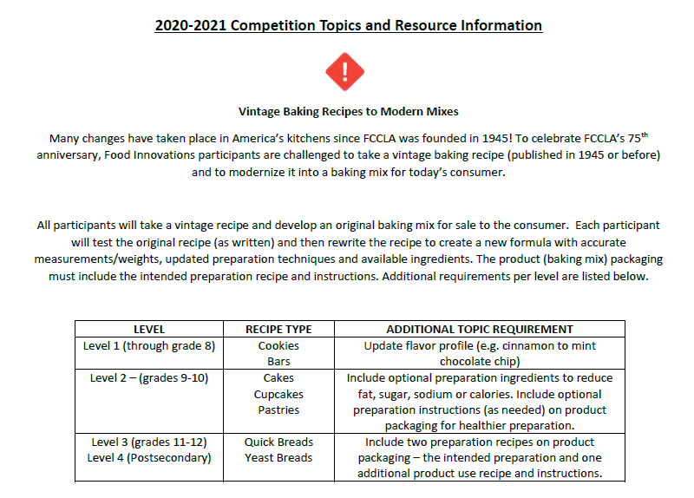

Slide 22
Hospitality, Tourism, and Recreation
Recognizes participants who demonstrate their knowledge of the hospitality, tourism, and recreation industries and ability to translate their knowledge into a hypothetical or real business. Project must relate to culinary, lodging, recreation, tourism or event coordination.
Levels 1, 2, 3
Individual or Team
Portfolio
Notes:
Examples:

Slide 23
Instructional Video Design
Recognizes participants who demonstrate their knowledge, skills, and abilities to research, plan, and create an instructional video to deliver content as part of a lesson or unit of instruction.
Levels 1, 2, 3
Individual or Team
ONLINE
Notes:
Due Feb 1

Slide 24
Interior Design
Recognizes participants who apply interior design skills learned in Family and Consumer Sciences courses to design spaces to meet client needs. In advance, participants will create design deliverables addressing the specifics of the design scenario.
Levels 2, 3
Individual or Team
Display
Notes:
Examples: Police Officer; BioChemistry Professor

Slide 25
Interpersonal Communication
Recognizes participants who use Family and Consumer Sciences and/or related occupations skills and apply communication techniques to develop a project designed to strengthen communication.
Level 1, 2, 3
Individual or Team
File Folder
Notes:
Now is an individual event and includes and ACF test

Slide 26
Job Interview
Recognizes participants who use Family and Consumer Sciences and/or related occupations skills to develop a portfolio, participate in an interview and communicate a personal understanding of job requirements.
Levels 2, 3
Individual
Portfolio (and interview)
Notes:
Examples: Police Officer; BioChemistry Professor

Slide 27
Leadership
Recognizes participants who actively evaluate and grow in their leadership potential. Participants use the Student Leadership Challenge and supporting materials, to investigate their leadership ability and develop a mentorship relationship to further their leadership development.
Levels 2, 3
Individual
Portfolio
Notes:
Now

Slide 28
National Programs in Action
Recognizes participants who explain how the FCCLA Planning Process was used to implement a national program project.
Levels 1, 2, 3
Individual or Team
File Folder
Notes:
Examples: Police Officer; BioChemistry Professor

Slide 29
Nutrition and Wellness
Recognizes participants who track food intake and physical activity for themselves, their family, or a community group and determine goals and strategies for improving their overall health.
Level 1, 2, 3
Individual or Team
Portfolio
Notes:
Now is an individual event and includes and ACF test

Slide 30
Parliamentary Procedure
Recognizes chapters that develop a working knowledge of parliamentary law and the ability to conduct an FCCLA business meeting.
Levels 1, 2, 3
Team
Knowledge Test & Demonstration Meeting
Notes:
Examples: Police Officer; BioChemistry Professor

Slide 31
Professional Presentation
Recognizes participants who make an oral presentation about issues concerning Family and Consumer Sciences and/or related occupations. Participants use visuals to illustrate content of the presentation.
Level 1, 2, 3
File Folder
Notes:
Now is an individual event and includes and ACF test

Slide 32
Promote and Publicize FCCLA!
Recognizes participants who develop an FCCLA promotion and publicity campaign to raise awareness and educate the school, parents, and members of the community about the importance of FCCLA and Family and Consumer Sciences education.
Levels 1, 2, 3
Individual or Team
Portfolio
Notes:
Examples: Police Officer; BioChemistry Professor

Slide 33
Public Policy Advocate
Recognizes participants who demonstrate their knowledge, skills, and ability to actively identify a local, state, national, or global concern, research the topic, identify a target audience and potential partnerships, form an action plan, and advocate for the issue in an effort to positively affect a policy or law.
Level 1, 2, 3
Individual or Team
Portfolio
Notes:
Now is an individual event and includes and ACF test

Slide 34
Repurpose and Redesign
Recognizes participants who select a used fashion or home apparel item to recycle into a new product.
Levels 1, 2, 3
Individual or Team
Display (and item)
Notes:
Examples: Police Officer; BioChemistry Professor

Slide 35
Say Yes to FCS Education
Recognizes participants who demonstrate the knowledge and skills needed to explore and experience the career of being a Family and Consumer Sciences educator. Participants must prepare a portfolio, conduct classroom observations, plan and execute a lesson, develop an FCCLA integration plan, and deliver an oral presentation.
Level 2, 3
Individual
Notes:
Now is an individual event and includes and ACF test

Slide 36
Sports Nutrition
Recognizes participants who use Family and Consumer Sciences skills to plan and develop an individualized nutritional plan to meet the needs of a competitive student athlete in a specific sport.
Levels 1, 2, 3
Individual or Team
File Folder
Notes:
Examples: Police Officer; BioChemistry Professor

Slide 37
Sustainability Challenge
Recognizes participants that address environmental issues (related to those chosen) that adversely impact human health and well-being and who actively empower others to get involved.
Levels 1,2, 3
Individual or Team
Portfolio
Notes:
1. Efforts to reduce food waste. https://www.epa.gov/sustainable-management-food
2. Efforts to reduce childhood exposure to lead. https://www.epa.gov/lead
3. Efforts to protect drinking water. https://www.epa.gov/ground-water-and-drinking-water/drinking-water-activitiesstudents-
and-teachers
4. Efforts to reduce household hazardous waste. https://www.epa.gov/hw/household-hazardous-waste-hhw
5. Efforts to promote appropriate use of pesticides. https://www.epa.gov/safepestcontrol

Slide 38
Teach and Train
Recognizes participants who demonstrate their ability to explore and experience the career of teaching or training. Participants must prepare a portfolio of the teaching/training career, prepare and execute a complete lesson/workshop plan and an oral presentation.
Levels 1, 2, 3
Individual
Portfolio
Notes:
Examples: Police Officer; BioChemistry Professor

Slide 39
Resources
National and State

Slide 40
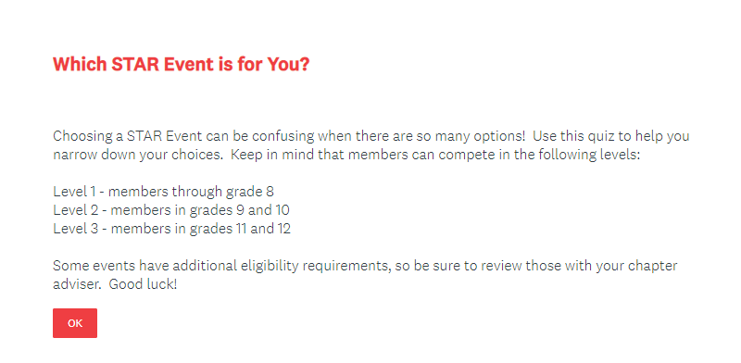
Which STAR Event is for You?
National Survey (SurveyMonkey)
Not super useful…
https://www.surveymonkey.com/r/KDSWGBT
Notes:
Only one question about interest

Slide 41
National YouTube Channel
STAR Event Demo Channel
Useful for exposure to events
Not always exemplary projects
Last updated in 2014
Old event names

Slide 42
National Competitive Events Guide
Available in the Advisor Resource Tab
Complete guide to events
Event specification guides & rubrics
Instructions For Virtual Submission
Notes:
It will be available until November 1 then you must be affiliated to access

Slide 43
State STAR Events Page
Quick guide to events
Levels and Team/Individual Info
https://mtfccla.org/competitive-events/star-events/

Slide 44
Montana Advisor Resource Guide
Coming Soon!
Updated Competitive Events Information Section
Notes:
Thank you to Whitney for updating!

Slide 45
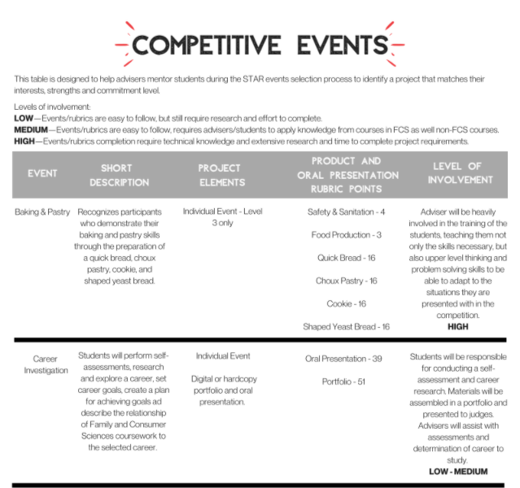

Slide 46
Reach Out!
Advisors across the state
District meeting presentations
Advisor and student judging

Slide 47
Questions?

